Slide 1
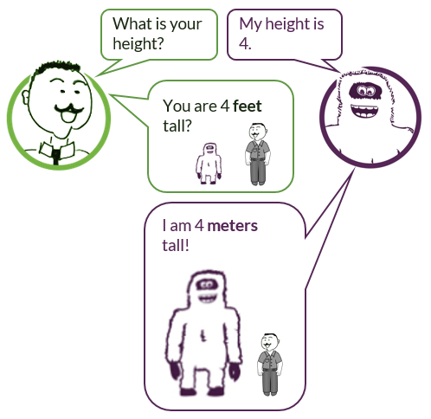

Without units of measurement, the meaning of numbers is not clear:
JUICE answers may require units!
DO include units when using numbers to give information about what you know, or when stating your answer.
Do NOT include units when you’re using numbers to calculate.

Slide 2
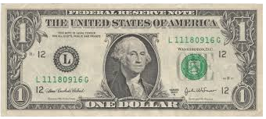
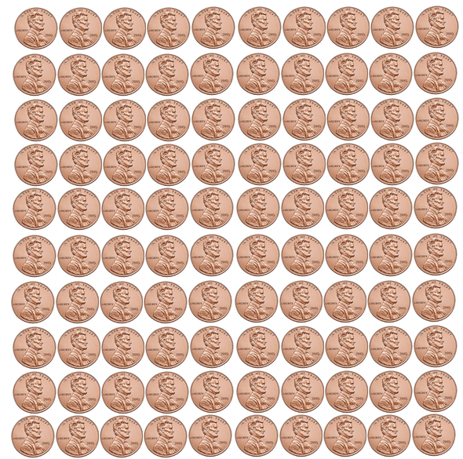


Currency
Dollars and cents
$1.00 = 100₵
1 dollar or $1.00
100 cents or 100₵
1₵ is $\frac{1}{100}$ of $1.00
1₵ is 1% of $1.00
1₵ can also be written $0.01

Slide 3


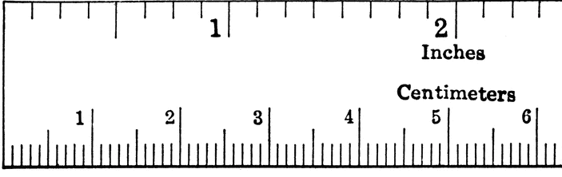
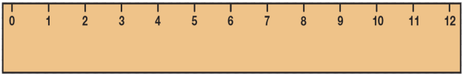
Length
Inch
Foot
abbreviation: in.
abbreviation: ft.
Many paperclips are about 1 inch long.
The length of men’s size 11 ½ shoe
is about 12 inches long.
1 inch = 1 in. = 1/12 of a foot
1 foot = 1 ft. = 12 in.

Slide 4
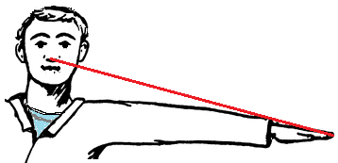
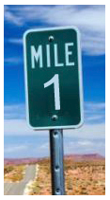
Length
Yard
abbreviation: yd.
From your nose to the tip of your finger is about a yard long.
Mile
abbreviation: mi.
If a car is going 60 miles per hour, it will take 1 minute to go 1 mile.
1 yard = 1 yd. = 3 ft. = 36 in.
1 mile = 1 mi. = 5280 ft.

Slide 5




Area
Square yard
Square foot
abbreviation: sq. yd.
abbreviation: sq. ft.
1 sq. ft.
1 sq. yd.
A square that is 1 foot long on all sides is a
square foot.
A square that is 1 yard long on all sides is a
square yard.

Slide 6
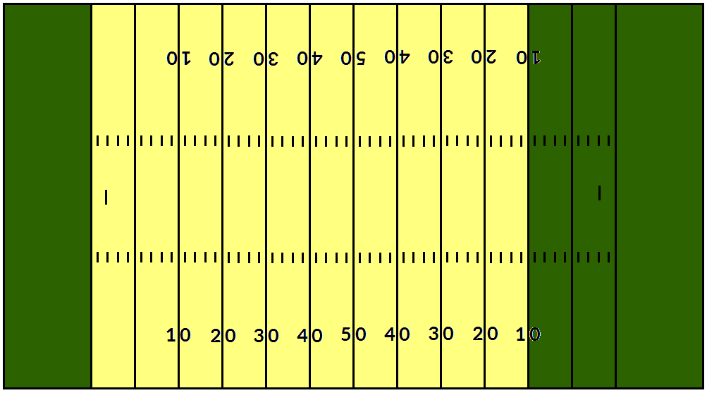

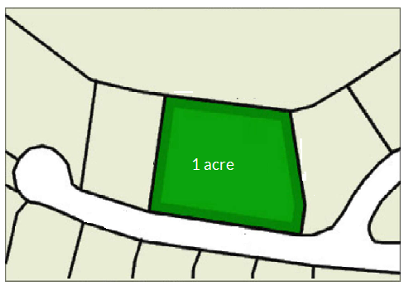
Area
Acre
abbreviation: ac.
A football field is 1.32 acres.
1 ac.
1 acre
Note: An acre does not have to be a rectangle. It can be any shape containing 43,560 sq. ft. This is an acre:
1 acre = 1 ac. = 43,560 sq. ft.
Brookdale Terrace

Slide 7
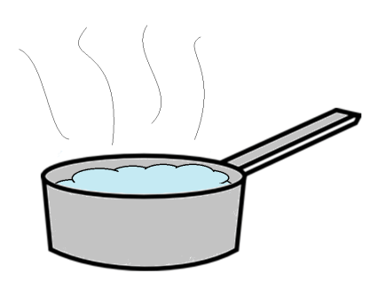
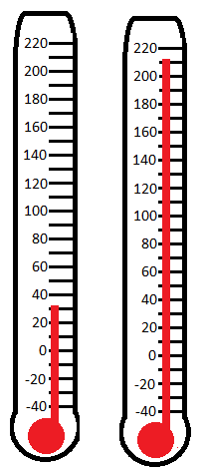
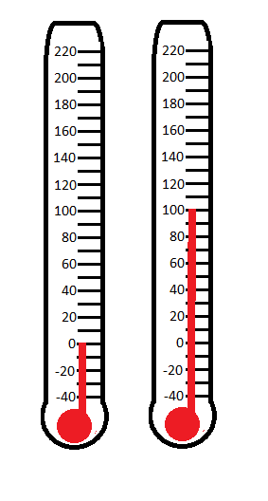



Temperature
Fahrenheit
Water freezes at 32ºF.
Water boils at 212ºF.
Celsius
Water freezes at 0ºC.
Water boils at 100ºC.
To change Celsius to Fahrenheit, use
this formula:
To change Fahrenheit to Celsius this formula:
Note: The symbol for degrees is º.

Slide 8
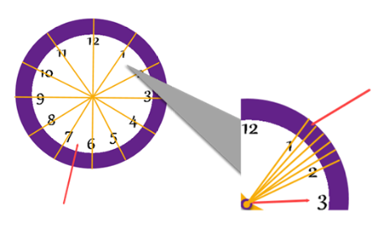
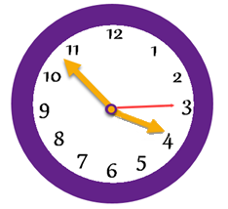
Time
Hours
abbreviation: hr.
Minutes
abbreviation: min.
Seconds
abbreviation: sec.
One day is divided into 24 equal parts called hours.
Each hour is divided into 60 equal parts called minutes.
Each minute is divided into 60 equal parts called seconds.
Each of these sectors represents 1 minute.
A clock represents a half-day, or 12 hours that correspond to the numbers on the clock.
Each of these sectors represent 5 minutes.
Since there are 5 sectors between each number and 12 numbers on the clock, there are 5 x 12 or 60 minutes represented on a clock.
1 day = 24 hr.
1 hour = 60 min.
1 minute = 60 sec.
1 hour = 60 x 60 = 3600 sec.

